Slide 1





General Setup

Slide 2
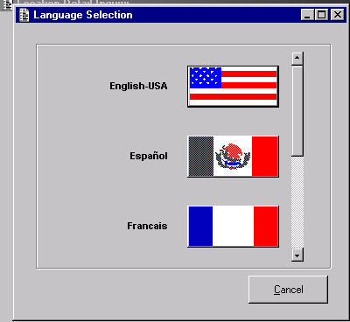
Global Retailing

Slide 3
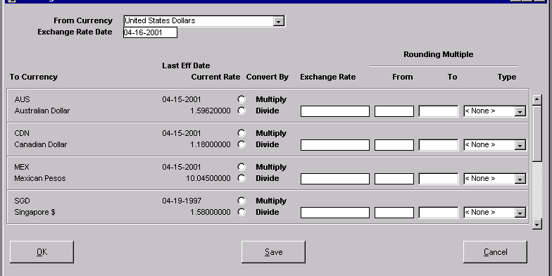
Buying / Selling in any Currency

Slide 4
Calendars
Merchandise
Financial
53 Week -13 Period
Configure to your needs
2003
2004
2005

Slide 5
Configurable Hierarchies
Product & Organization
Unlimited Levels
Names are User Definable
Sales & Inventory Summaries
Retailer, Inc.
Other Banner
West
Region
Central
Region
East
Region
North
South
East
Country
Urban
Business Benefits?
Support future business growth
Support organizational changes
Quick easy access to data
Fairfield
Forum
Crows Nest
Cherrybrook

Slide 6
Alternate Hierarchies
All Products
Reporting
Hierarchy
POS Hierarchy
Warehouse
Hierarchy
Grocery
Apparel
Hardgoods
Category
Category
Category
POS Hierarchy
Vendor
Legacy Integration

Slide 7

Store/DC Information
Country of Operation
Currency
General Ledger Company
Opening Date
Distribution Date
Comp Date
Closed Dates
Store Attributes
Retailer Defined Fields
Assortment Formats
Address
Taxation

Slide 8
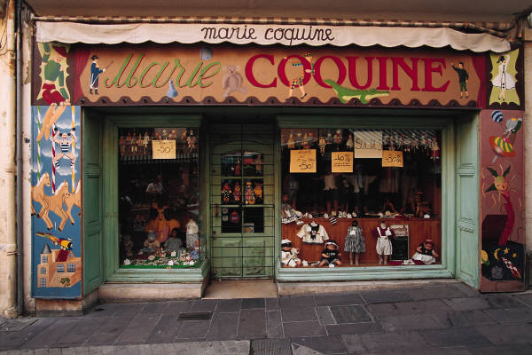
Franchise Support
Store Type
Unique Cost Assignment
Option to Track Perpetual
Inventory Movement tracked Separately
Inventory is “Sold” to the Franchised location

Slide 9
Multiple Banner Support
Unlimited Organizational Levels & Occurrences
Unlimited Price/Cost Chains
Unlimited G/L Entities
Retailer, Inc.
Other Banner
West
Region
Central
Region
East
Region
North
South
East
Country
Urban
Fairfield
Forum
Crows Nest
Cherrybrook

Slide 10
General Setup

